Slide 1


PLEDGE TO PROGRESS Sustainability Hackathon
Sponsored By
Your Team Name : EcoSnap
Your team bio : Go Green Go EcoSnap
Date :02/04/2023

Slide 2
Problem Statement
Green Software: Building Sustainable Tools and Frameworks for Reducing Carbon Footprint in Software Development
The technology industry has a significant impact on the environment, with software development being one of the biggest contributors. The growing demand for technology has led to an increase in energy consumption and carbon emissions, which have adverse effects on the environment. Green software is a new approach to software development that aims to reduce the environmental impact of technology.
The challenge is to build intelligent tools and frameworks that will guide and enable developers and the larger tech community to design and build green code.
Why I chose it?
1. Reducing our carbon footprint is important because it mitigates the effects of global climate change, improves public health, boosts the global economy, and maintains biodiversity. When we cut carbon emissions we help ensure cleaner air, water, and food for our generation and for generations yet to come.
2. One has to see it and have it be laid out for them in some ways that make this change very tangible, visible and beneficial.

Slide 3
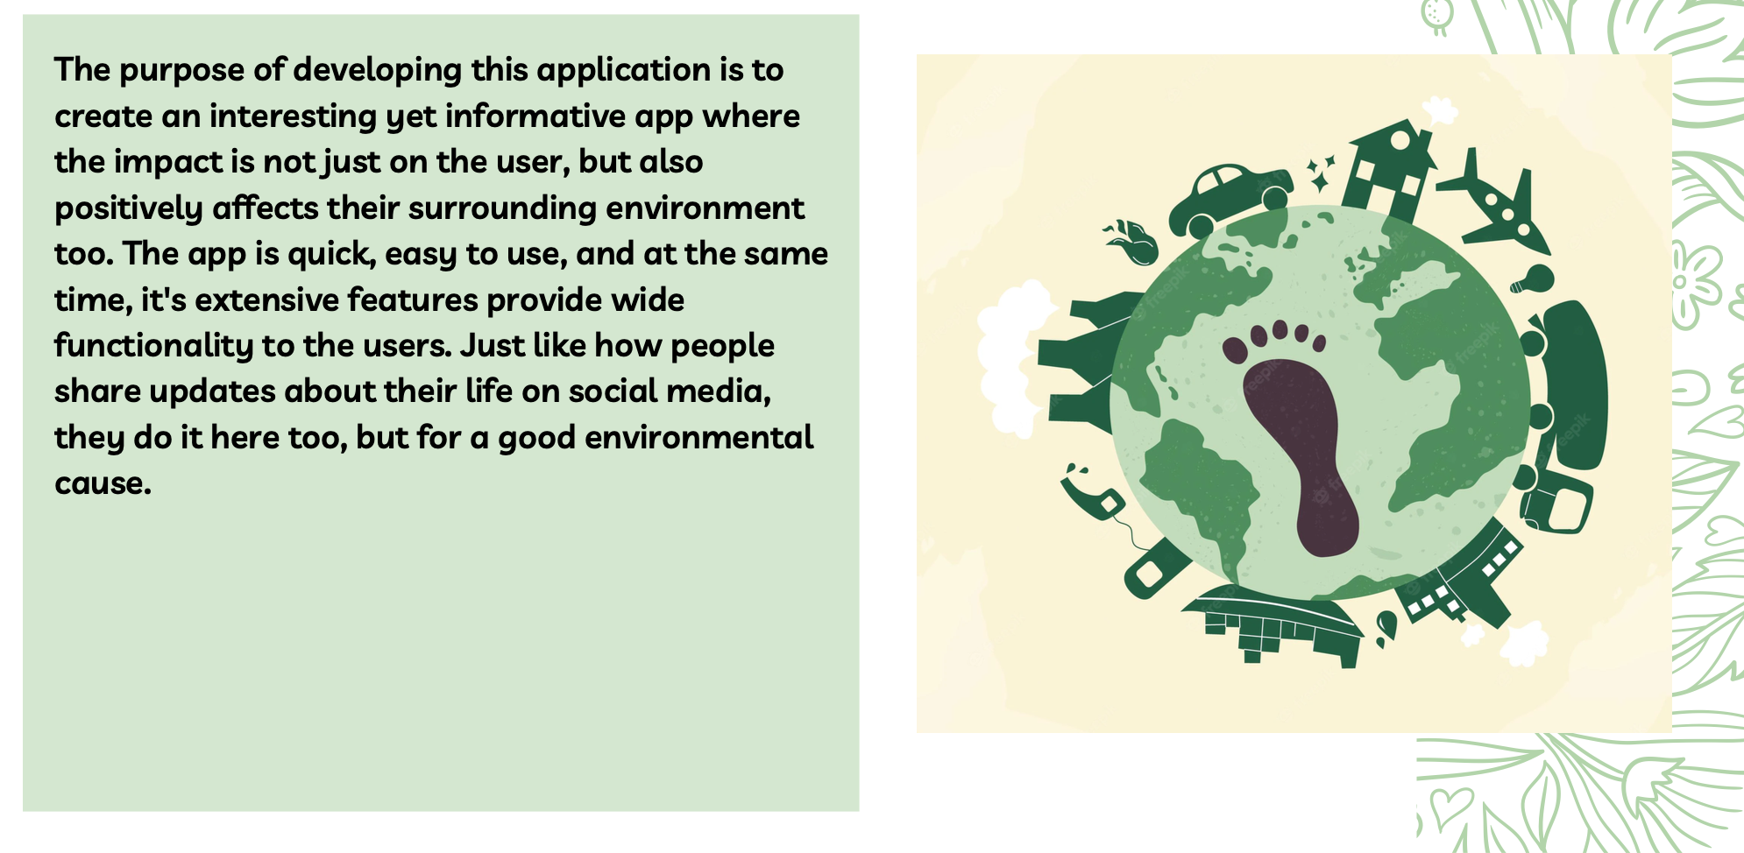
User Segment & Pain Points
People, especially the youth in this generation needs something quick, easy to interpret, and yet impactful.
The people need an 'Info-Tainment' approach to actually use a platform and monitor their performance.
So making an app that goes with the GenZ style is the most preferred one as they are the future and going in their world and making them understand the problems would make more sense and improve the scope of this app.

Slide 4
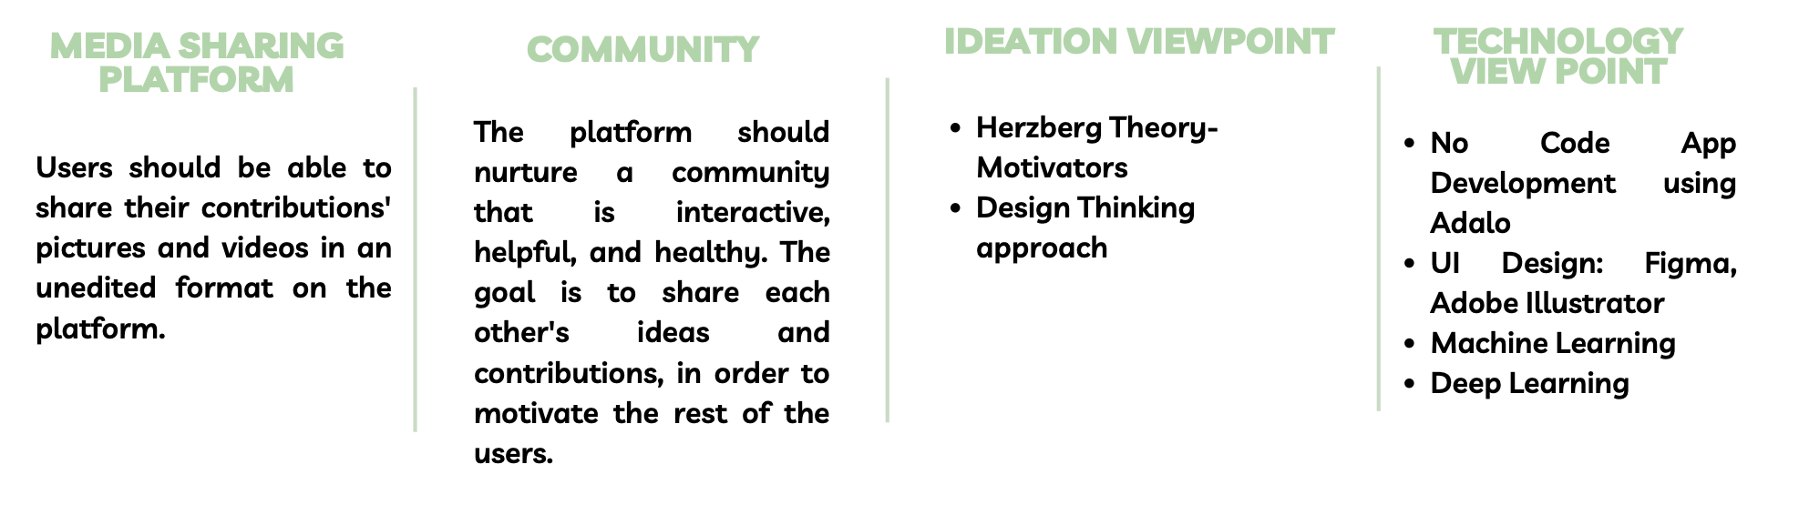
Tools or resources

Slide 5
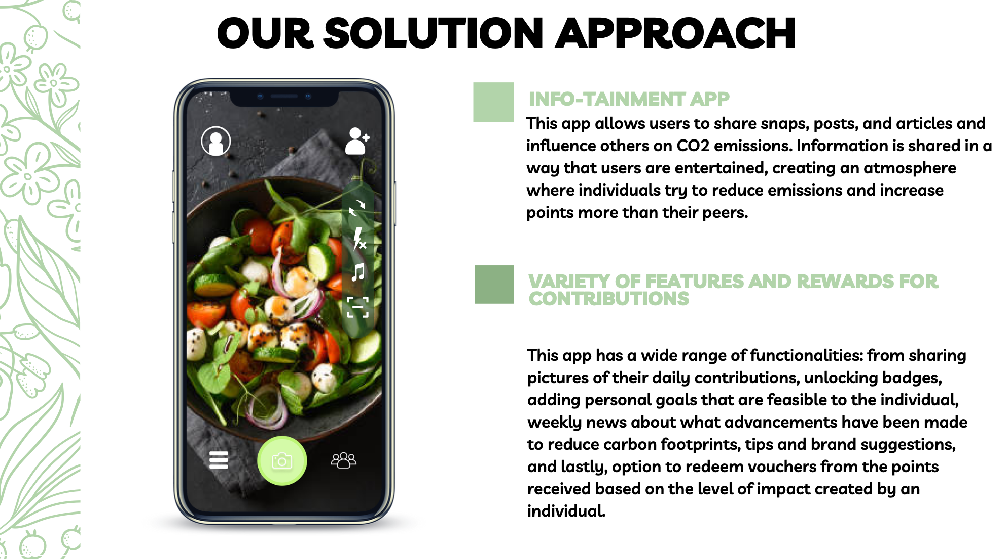
Any Supporting Functional Documents

Slide 6
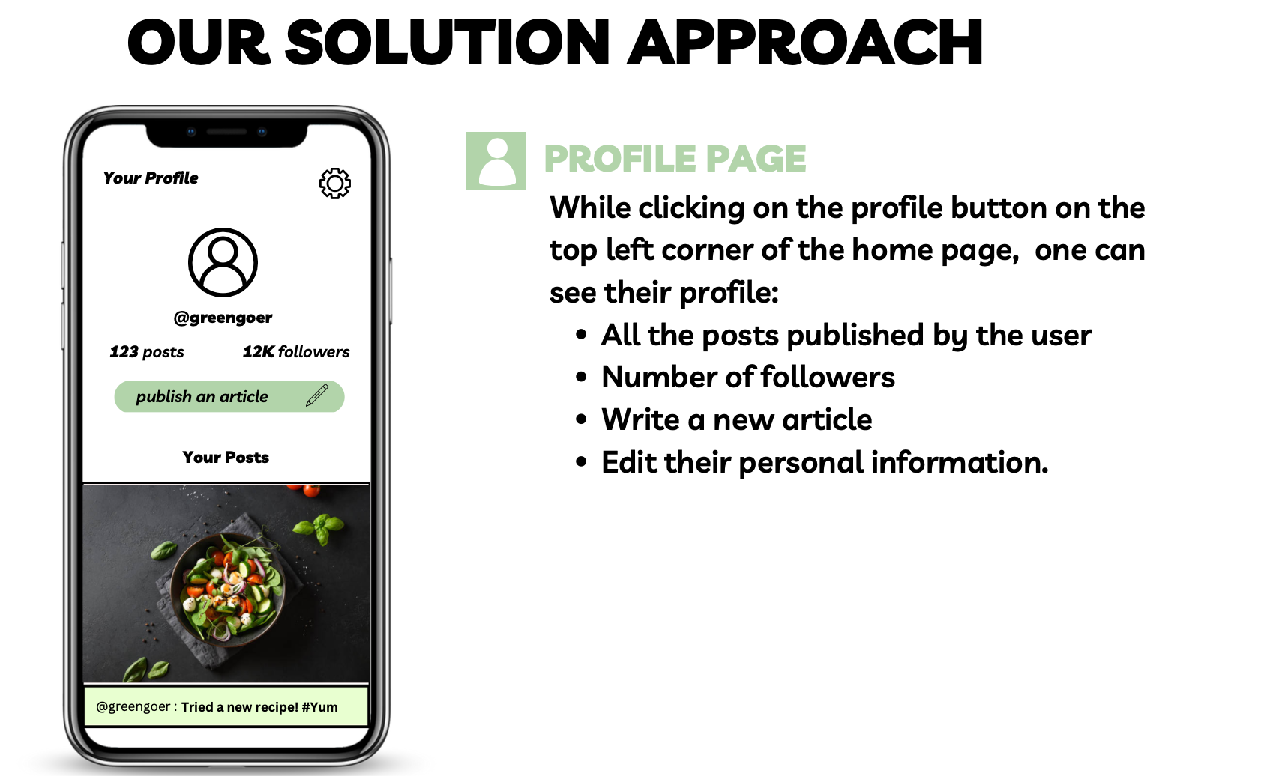
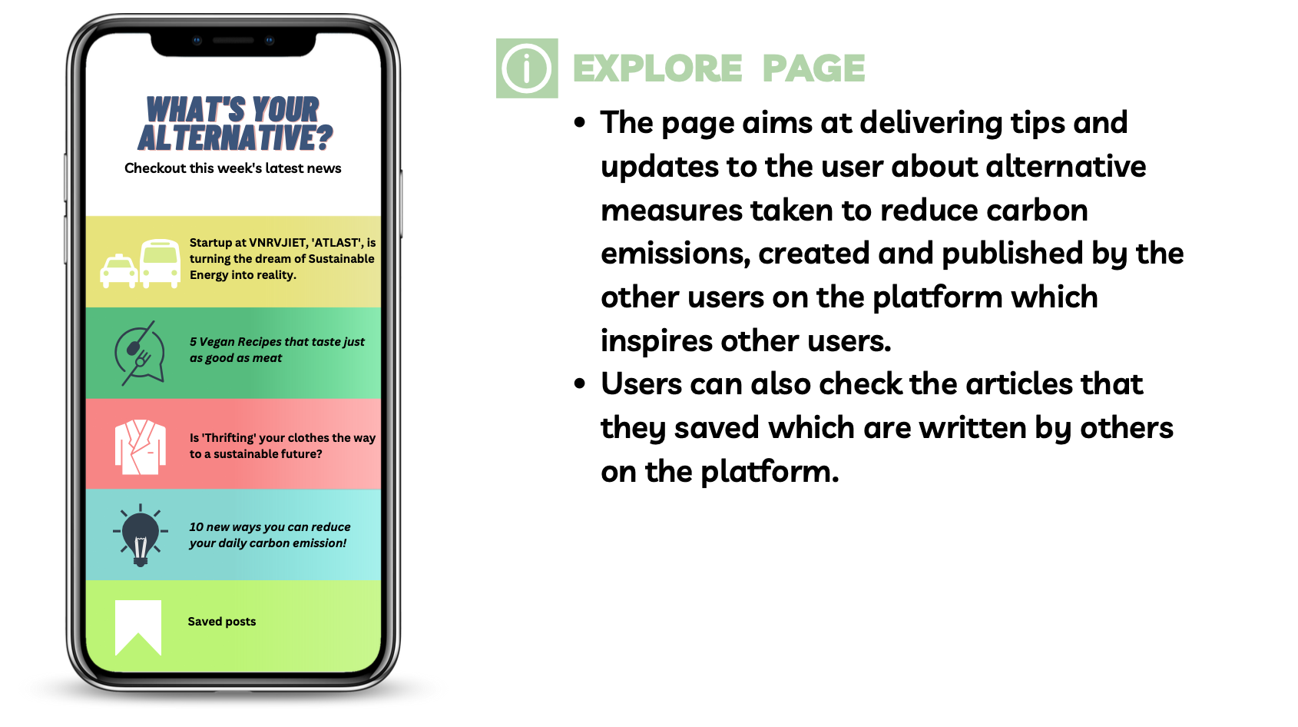
Key Differentiators & Adoption Plan

Slide 7
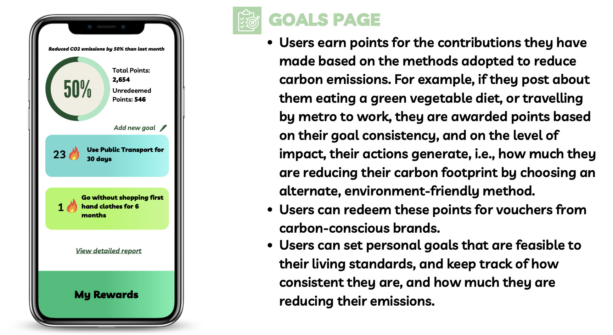
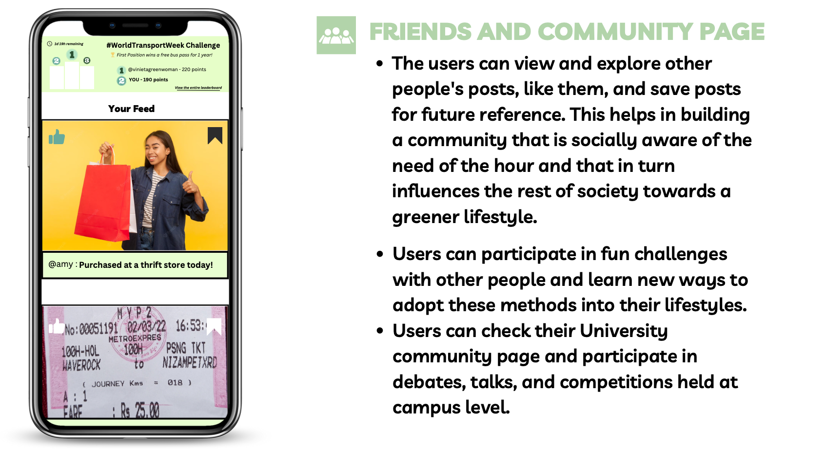

Slide 8

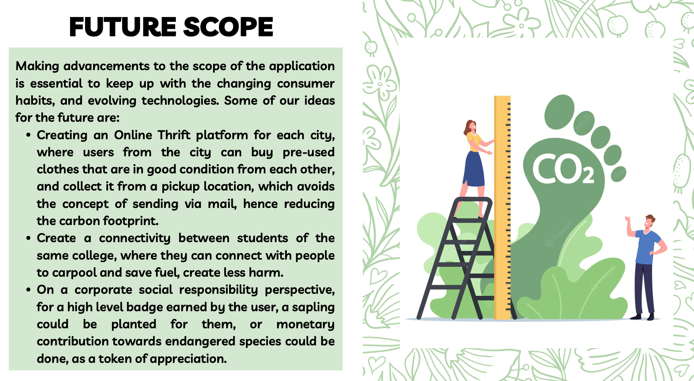

Slide 9

Thank You
K.Satwik Reddy
satwik.vnr@gmail.com

